Slide 1
Closed Conduit Measurement Techniques
Pipeline systems
Transmission lines
Pipe networks
Measurements
Manifolds and diffusers
Pumps
Transients
You are here

Slide 2
Measurement Techniques
Direct Volume or Weight measurements
Velocity-Area Integration
Pressure differential
Pitot Tube
Venturi Meter
Orifice
Elbow Meter
Electromagnetic Flow Meter
Turbine Flow Meter
Vortex Flow Meter
Displacement Meter
Ultrasonic flow meter
Acoustic Doppler
Laser Doppler
Particle Tracking

Slide 3
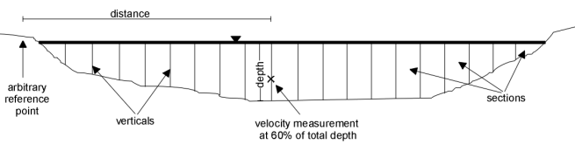
Some Simple Techniques...
Direct Volume or Weight measurements
Measure volume and time (bucket and stopwatch)
Excellent for average flow measurements
Velocity-Area Integration
Stream flow

Slide 4
Pitot Tube
Stagnation pressure tap
Static pressure tap
2
V₁ =
0
V
1
z₁ = z₂
Connect two ports to differential pressure transducer. Make sure Pitot tube is completely filled with the fluid that is being measured.
Solve for velocity as function of pressure difference

Slide 5
Venturi Meter
1797 - Venturi presented his work on the Venturi tube
1887 - first commercial Venturi tube produced by Clemens Herschel
Minimal pressure loss
1
2
Yes!
Contraction
Bernoulli equation applicable?_______ Why?

Slide 6
Venturi Meter Discharge Equation
1
2
C_{v} is the coefficient of velocity. It corrects for viscous effects (energy losses) and velocity gradients (α).
K_{venturi} is ≅1 for high Re and small D₂/D₁ ratios

Slide 7
Orifice
2.5 D
8 D
Δh
D
The flow coefficient, K_{orifice}, is a function of the ratio of orifice diameter to pipe diameter and is a weak function of ________ number.
Reynolds

Slide 8
Elbow Meter
Acceleration around the bend results in higher pressure at the outside of the bend
Any elbow can be used as the meter
Needs to be calibrated (no standard calibration curves are available)

Slide 9
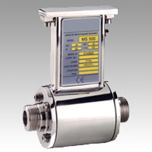
Electromagnetic Flow Meter
Conductor moving through a magnetic field generates an _______ field.
Voltage is proportional to velocity
Causes no __________ resistance to flow
High signal amplification is required
magnet
electric
conductive fluid
electrodes
“measurable”
measure voltage here

Slide 10
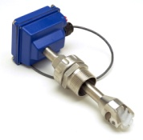
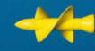
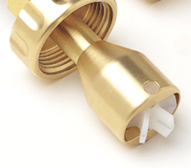
Turbine and Paddle Wheel Flow Meters
Simply a turbine mounted in a pipe held in a stream
The angular velocity of the turbine is related to the velocity of the fluid
Can operate with relatively low head loss
Needs to be calibrated
Used to measure _________ ___ ____ or ___________
volumetric flow rate
velocity

Slide 11
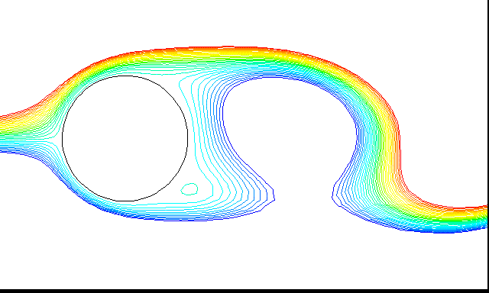

Vortex Flow Meter
Vortex shedding
Strouhal number, S, is constant for Re between 10⁴ and 10⁶
Vortex shedding frequency (n) can be detected with pressure sensors
d
L

Slide 12
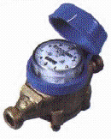
Displacement Meter
Used extensively for measuring the quantity of water used by households and businesses
Uses positive displacement of a piston or disc
Each cycle of the piston corresponds to a known volume of water
Designed to accurately measure slow leaks!

Slide 13

Ultrasonic Flow Meters: Doppler effect
The transmitted frequency is altered linearly by being reflected from particles and bubbles in the fluid. The net result is a frequency shift between transmitter and receiver frequencies that is proportional to the velocity of the particles.
Doppler shift
Sound velocity
Transmitted frequency
http://www.sensorsmag.com/articles/1097/flow1097/main.shtml

Slide 14
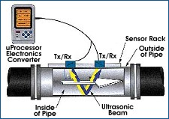
Ultrasonic Flow Meters: Transit Time
Measure the difference in travel time between pulses transmitted in a single path along and against the flow.
Two transducers are used, one upstream of the other. Each acts as both a transmitter and receiver for the ultrasonic beam.

Slide 15
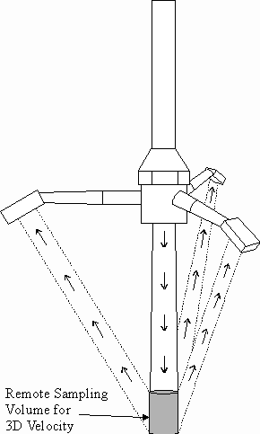
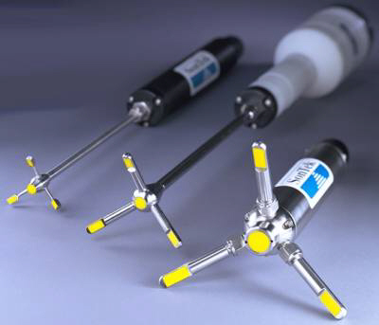
Acoustic Doppler Velocimeter
http://www.sontek.com/
Point
_______ measurement

Slide 16
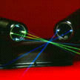
Laser Doppler Velocimetry
a single laser beam is split into two equal-intensity beams which are focused at a point in the flow field.
An interference pattern is formed at the point where the beams intersect, defining the measuring volume.
Particles moving through the measuring volume scatter light of varying intensity, some of which is collected by a photodetector.
The resulting frequency of the photodetector output is related directly to particle velocity.
_______ measurement
http://www.tsi.com/
Point

Slide 17
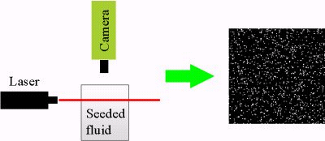
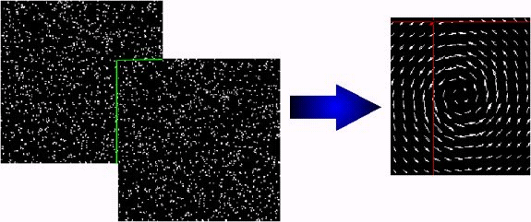
Particle Tracking Velocimetry
Illuminate a slice of fluid (seeded with particles) with a laser sheet
Take a high resolution picture with a digital camera
Repeat a few milliseconds later
Compare the two images to determine particle displacement
Measures _______ ______
velocity field
http://amy.me.tufts.edu/

Slide 18
Questions to Ponder
Will an ADV need to be recalibrated if it is moved from freshwater to saltwater?
A graduate student proposes to use an LDV in a wave tank (through a glass bottom) that is stratified with freshwater on top of saltwater to measure turbulence from the breaking waves. What problems might arise?
How could the flow normal to the plane of the light sheet be estimated using PTV?
Would it be possible to know the direction of the flow in the 3rd dimension?

Slide 19
More Questions to Ponder
Why would a flow meter manufacturer specify that the pipe used for installing the meter must be straight for 10 diameters upstream and 5 diameters downstream from the meter?
How could an ultrasonic device get information about velocity at more than one location without moving (profiling)?
How could you apply the results from profiling to improve the flow rate measurement in a pipe?

Slide 20
Orifice Example
Estimate the orifice diameter that will result in a 100 kPa pressure drop in a 6.35 mm I.D. pipe with a flow rate of 80 mL/s. The orifice coefficient (K_{orifice}) is 0.6.
What is β, the ratio of orifice diameter to pipe diameter?
If the smallest pressure differential that can accurately be measured with the pressure sensor is 1 kPa, what is the smallest flow that can accurately be measured using this orifice?
What are two ways of extending the range of measurement to lower flows?

Slide 21
Orifice Solution
Estimate the orifice diameter that will result in a 100 kPa pressure drop in a 6.35 mm I.D. pipe with a flow rate of 80 mL/s. The orifice coefficient (K_{orifice}) is 0.6.

Slide 22
Orifice Solution
What is β, the ratio of orifice diameter to pipe diameter?
If the smallest pressure differential that can accurately be measured with the pressure sensor is 1 kPa, what is the smallest flow that can accurately be measured using this orifice?
What are two ways of extending the range of measurement to lower flows?
(0.546)
8 mL/s

